Slide 1


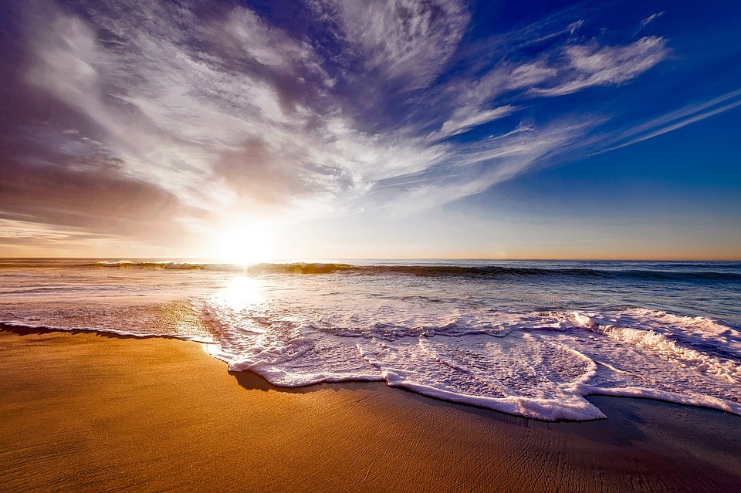
MIC Smart Beach by Bruce County
Sanjeev Kumar - Professor
Brunilda Xhaferllari – Project Manager
Rich Freeman – Faculty Menton
AI Team:
Janvi Patel
Fangji Chen
Scaria Ouseph Kurian
Notes:
Image: 12019 (2016) Ocean waves crashing on shore during daytime https://pixabay.com/photos/beach-sea-sunset-sun-sunlight-1751455/

Slide 2

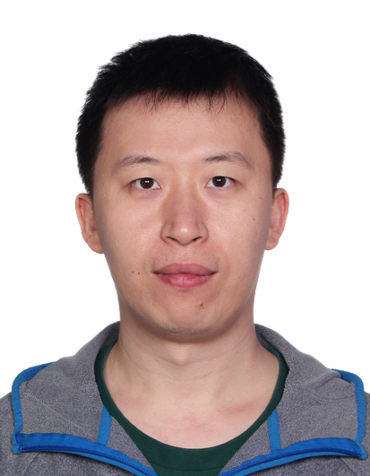


Our Team
Janvi
Patel
Scaria Ouseph Kurian
Fangji Chen
Project Lead / Communicator
Developer
Analyst

Slide 3
Project Summary
The smart beach project is a three-year pilot project that will provide swimmers with up-to-date information on water conditions.
The general project agenda is to use buoy(National oceanic and atmospheric administration) data and camera images to predict future water conditions.
There are 3 questions provided by MIC to the whole team of the which AI team will be working on the following question.
Predict the wave conditions and current visible in the camera images, as well the number and distribution of people on the beach and in the water.

Slide 4
Work done till now
Introduction to the project.
Client Requirements.
Suggestions on image anonymizing Software.

Slide 5
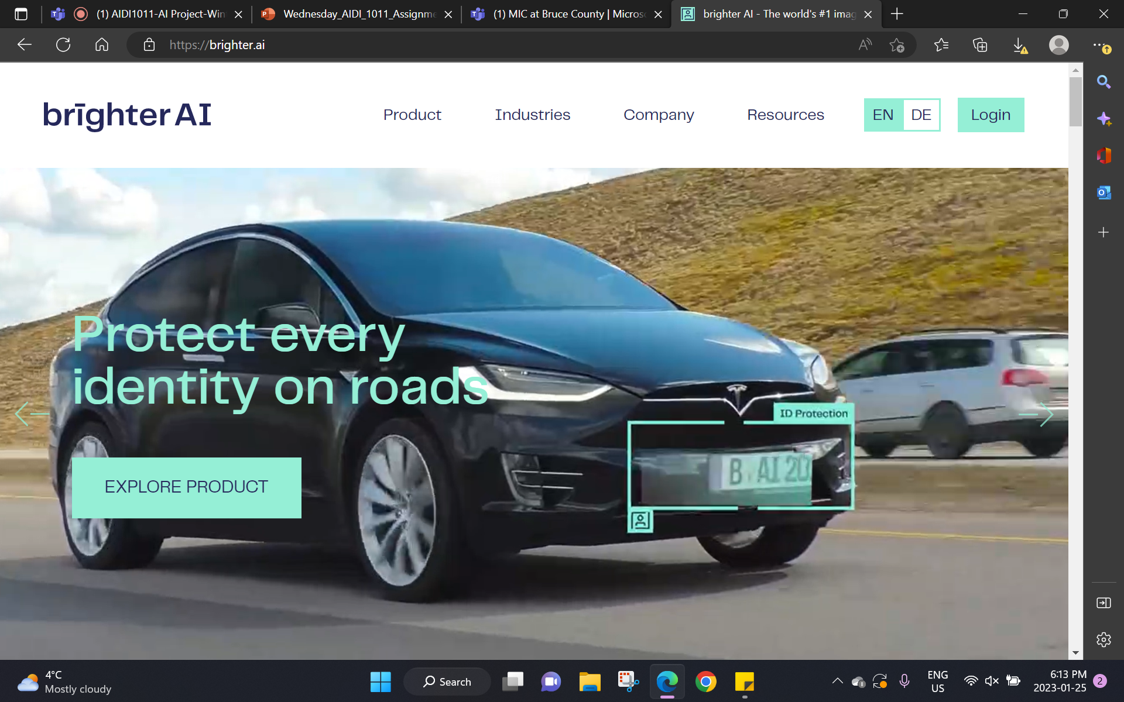
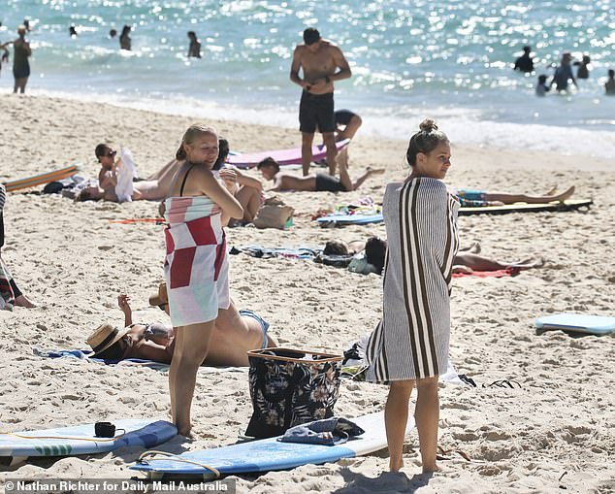
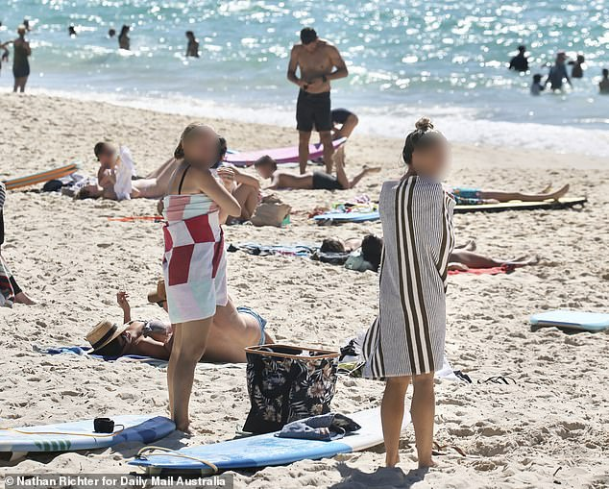
Image anonymizing techniques
Before: After:

Slide 6

Brighter AI
Easy-to-use: Simple integration via cloud API or online user interface
Precise: >99% anonymization accuracy
Fast: Fully automatic, AI-powered anonymization software
Secure: Hosted on MS Azure with TLS encrypted API
AI-compatible: Deep Natural Anonymization (DNAT) enables analytics and machine learning compatibility
Compliance: Anonymized data by nature not personal and therefore not subject to data privacy regulations (GDPR, CCPA, CSL/PIS, etc.)

Slide 7
YOLOv5
YOLOv5 is the most efficient algorithm for object detection.
We can train the data with people as object.
It uses Pytorch and OpenCV library.
As it uses python it is convenient for large datasets.

Slide 8
Wave current and condition
Rip currents are a daily possibility on beaches worldwide. However, most of the time, they are so weak that swimmers rarely notice them.
Beaches are a popular place to relax, especially during the summer; however, they also present the danger of the occurrence of rip currents.
YOLO

Slide 9
Next Steps:
Work on few images provided by Dr. Smith.
Plan our project.
Will start coding with extra data from internet.

